Slide 1
Ecommerce Website Using Django
Submitted by
SHILPA SATHEESAN S

Slide 2
EXISTING SYSTEM
Traditionally, customers are used to buying the products at the real, in other words, factual shops or supermarkets.
It needs the customers to show up in the shops in person, and walk around different shopping shelves, and it also needs the owners of shops to stock, exhibit, and transfer the products required by customers.
It takes labour, time and space to process these operations.

Slide 3
PROPOSED SYSTEM
We propose a web application that allows business personnel to make their total business using it and increase their reachability thousands of times more than today they have, over the internet.
With this authorized Customers do not need to go to the factual shops to choose, and bring the products they need by hands. They simply browse their Personal computers or cell phones to access shops, and evaluate the products description, pictures on the screen to choose products.
In addition, the owners of the shop do not need to arrange or exhibit their stocks products. They just input the description, prices of products, and upload their pictures. Simply, both customers and shop owners do not need to touch the real products in the whole process of shopping, and management
The customers are able to track the status of their orders until delivery.

Slide 4
PROBLEM DEFINITION
Customers used to buy the products at the real, in other words, factual shops or supermarkets. It needs the customers to show up in the shops in person, and walk around different shopping shelves, and it also needs the owners of shops to stock, exhibit, and transfer the products required by customers. It takes labour, time and space to process these operations.
Furthermore, the spread of the Covid-19 pandemic has caused a lot of changes in our lifestyle, people fearing to get outside their homes, transportation almost shut down and social distancing becoming all the more important.

Slide 5
PROBLEM DEFINITION
Big to small scale business that relied on the traditional incur a lot of consequence due to the lockdown issues. Some tend to more towards using social media platforms like Facebook to sell their product. However, the social media platforms have been beneficial for marketing purposes alone but leaves the whole task of customer and massive order management via direct messaging (DM), which takes a lot of time to respond to all customers. In addition, everyone tends to use social media, posing a great challenge to differentiate between scammers (fraudsters) and legit sellers.

Slide 6
OBJECTIVE OF THE PROJECT
The main objective of the project is to develop an online platform . The system aims to achieve the following objectives:
• To design an online website for ecommerce.
• To provides a solution to reduce and optimize the expenses of customer order management.
• To create an avenue where people can shop for products online.
• To develop a database to store information on products and services.
• To make payment and place the order 24x7 by using their Personal computers or cell phones.

Slide 7
SCOPE OF THE PROJECT
The goal of this project is to develop an online ecommerce system, this system will be designed keeping in mind the conditions easy to use, feasibility and user friendly.
It may help in effective and efficient order management.
In every shot time, the collection will be obvious, simple and sensible.
It is very possible to observe the customer potentials and purchase patterns because all the ordering history is store in the database.
It is efficient managing all the operations of an online store within a single platform

Slide 8
DATABASE DESIGN
Admin Module
Admin can provide username, email, password and your admin account will be created.
After login, there is a dashboard where admin can see how many customers is registered, how many products are there for sale, how many orders placed.
Admin can add/delete/view/edit the products.
Admin can view/edit/delete customer details.
Admin can view/delete orders.
Admin can change status of order (order is pending, confirmed, out for delivery, delivered)
Admin can view the feedbacks sent by customers

Slide 9
DATABASE DESIGN
Customer Module
Customer can view/search products without login.
Customer can also add/remove product to cart without login (if customer try to add same product in cart. It will add only one)
When customer try to purchase product, then he/she must login to system.
After creating account and login to system, he/she can place order.
If customer click on pay button, then their payment will be successful and their order will be placed.
Customer can check their ordered details by clicking on orders button.
Customer can see the order status (Pending, Confirmed, delivered) for each order
Customer can download their order invoice for each order
Customer can send feedback to admin (without login)

Slide 10
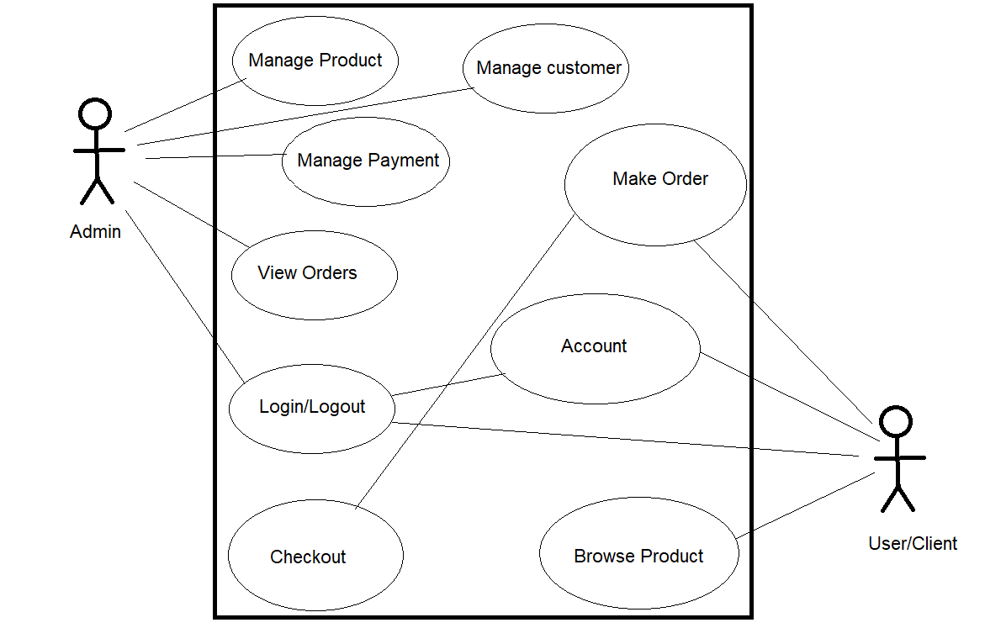
USE CASE DIAGRAM

Slide 11
CLASS DIAGRAM

Slide 12
payments
payments_id: int(100)
amount: int(100)
customer_id: int(100)
product_id: int(100)
trx_id: varchar (225)
currency : int(100)
payment_date:date
admins
admin_id: int(10)
admin_fname: varchar(255)
admin_Iname: varchar(255)
admin_email: varchar(255)
admin_password: varchar(255)
admin_address: varchar(255)
admin_sex: varchar(255)
admin_postcode: varchar(255)
customers
customers_id: int(10)
customers_ip: varchar(255)
customers_fname:text
customers_Iname:text
customers_email: varchar(100)
customers_pass: varchar(100)
customers_postcode: varchar(100)
customers_city: text
customers_phone: varchar(255)
customers_address: text
customers_image: text
orders
Orders_id: int(100)
p_id: int(100)
C_id: Int(100)
Qty: int(100)
Invoice_no: int(100)
Status: tect
Order_date: date
cart
p_id:int(10)
Ip_add:varchar(255)
qty:int(10)
products
product_id: int(100)
product_cat: int(100)
product_brand: int(100)
product_title: varchar(255)
product_price: int(100)
product_desc: text
product_image: text
product_keywordstext
brands
brand_id:int(100)
brand_title:text:text
brand_desc:text
categories
cat_id:int(100)
cat_title:text
cat_desc:text

Slide 13
HARDWARE AND SOFTWARE SPECIFICATION
SOFTWARE INTERFACES
Operating System - Windows XP or above versions.
Language Used (Front End) - HTML, CSS
Language Used (Back End) - Python Django Framework
Web Browser - Google Chrome
HARDWARE INTERFACES
Processor Name - AMD Athlon 300U
Processor Speed - 2.40 GHz
RAM - 1 GB
Hard Disk Capacity - 80 GB
Display Device - 14‘ to 19‘ Inch
Monitor Keyboard Type - PS2 or USB
Mouse Type - PS2 or USB

Slide 14
THANK YOU

